Slide 1
This Keyword
Presented by,
N. Harsha Vardhan

Slide 2
What is this keyword?
This is a keyword in Javascript which is useful in setting a context to a function.
This is like any other parameter but the only difference is that you don’t provide it during the function call.
Generally this would point to the enclosing lexical context.
This keywords functionality changes with the usage.
Some of the changes can be observed when we use the function in strict mode, or when we use arrow functions, callbacks, etc

Slide 3
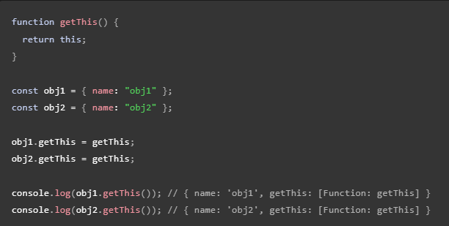
This keyword normal usage.
As you can see the this keyword returns the context which is prefixed with.
The function getThis will return the this value.
When we consider the obj1 we assign it to the getThis function this would return the obj reference to obj1.

Slide 4
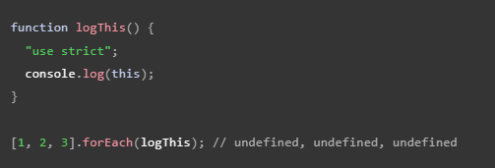

This keyword with callbacks
When a function is passed as a callback, the value of this depends on how the callback is called, which is determined by the implementor of the API.
Callbacks are typically called with a this value of undefined (calling it directly without attaching it to any object), which means if the function is non–strict, the value of this is the global object (globalThis). This is the case for iterative array methods, the Promise() constructor, etc.

Slide 5

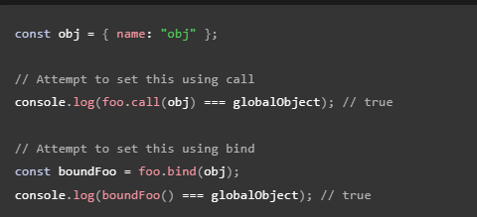
This keyword with Arrow functions
Arrow functions unlink the regular functions doesn’t have its own this binding it would use the enclosing lexical context.
This doesn’t change even if we call, apply or bind context to this functions.

Slide 6
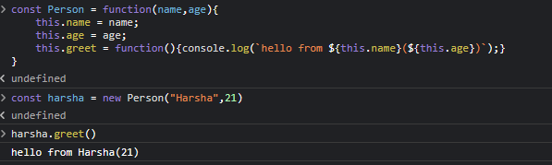
This Keyword with constructor
We can use this to bind the variable to the context and when we use the new keyword with the function all the variables with this context are returned.
This would point to the newly created object.

Slide 7
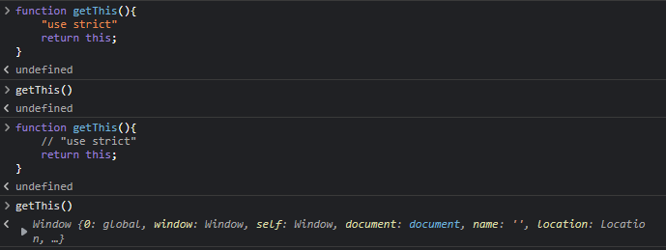
This keyword with Strict mode
When a function uses strict mode the this is remains undefined. Until it has a proper way of initializing the this value.
The proper way of initializing is by obj prefixing of call, apply, or binding.
Normally this would be initialized to global This if we have the this value as undefined or null. (This is known as This substitution).

Slide 8
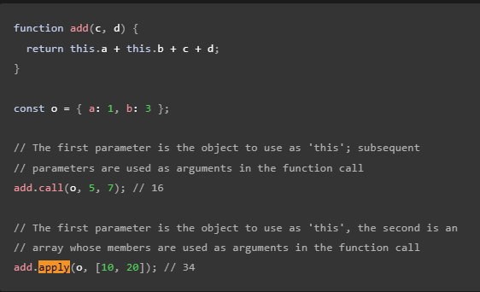
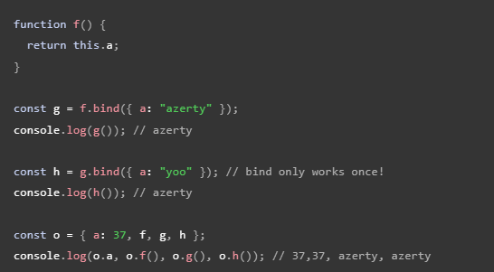
This keyword with call, apply and bind functions.
Call function help provide the context to the function with a obj and extra parameters
Apply function also does the same thing but the parameters would be passed as an array.
Bind is slightly different from the above functions. Bind function binds the context and returns a new function which we can use later.

Slide 9
Thank you

